Slide 1
Paravalvular leak
PRESENTER -
DR FARHAN P K
SR – CARDIOLOGY
GMCH KOZHIKODE
CHAIR -
DR KADER MUNEER
CARDIOLOGY
GMCH KOZHIKODE

Slide 2
References
Text book of clinical echocardiography - Catherine Otto Ed 6
Topol Text book of interventional cardiology Ed. 8
Journal of the American Society of Echocardiography Volume 22 Number 9
Practice guidelines for perioperative TEE. A report by the American Society of Anesthesiologists and the Society of Cardiovascular Anesthesiologists Task Force on TEE. Anesthesiology 1996;84:986-1006
Closure of prosthetic paravalvular leaks: a long way to go; Carlos E. Ruiz
Krishnaswamy, Amar, Samir R. Kapadia and E. Murat Tuzcu. “Percutaneous paravalvular leak closure- imaging, techniques and outcomes.” Circulation journal : official journal of the Japanese Circulation Society 77 1 (2013): 19-27 .
Intravascular lithotripsy (IVL) enabled the percutaneous closure of a severely calcified paravalvular leak regurgitation following implantation of a self-expandable transcatheter aortic valve: a case report
Ruiz CE, Hahn RT, Berrebi A, Borer JS, Cutlip DE, Fontana G, Gerosa G, Ibrahim R, Jelnin V, Jilaihawi H, Jolicoeur EM. Clinical trial principles and endpoint definitions for paravalvular leaks in surgical prosthesis. European heart journal. 2018 Apr 14;39(15):1224-45.

Slide 3
A comprehensive review of the diagnosis and management of mitral paravalvular leakage Mustafa Ozan Gürsoy. Anatol J cardiol 2020
Clinical Experience With Percutaneous Left Ventricular Transapical Access for Interventions in Structural Heart Defects. Vladimir Jelnin et al. JACC 2011

Slide 4
All the Prosthetic valve leaks are significant.…?
Prosthetic valve regurgitation
Transvalvular
Physiological
(all mechanical PV,
upto 50% of BPV)
Pathological
Paravalvular
(PVL)
Significance...?
Notes:
Trivial to mild physiological valvular regurgitation.
Spatial patterns of regurgitation jet corresponds to the fluid dynamics of each valve type

Slide 5
Physiologic regurgitation :
Closing volume - a displacement of blood caused by the motion of the occluder
True trivial or mild regurgitation at the hinges of the occluder
This “built-in” regurgitation theoretically prevents blood stasis & thrombus formation using a washing effect
Physiological regurgitation consists of > 1 jets inside the sewing ring should be distinguished from paravalvular flow external to the sewing ring

Slide 6
Bioprosthetic valves : Trivial central leak
Bileaflet valve : Multiple jets
Tilting disk valve : @ the edge of major orifice
Starr-Edwards valve : Small closing volume
Notes:
1. at the central coaptation point of all 3 leaflets
2. Bileaflet :2 criss cross regurgitation jets are seen in the plane parallel to the leaflet opening plane + two smaller diverging jets in the perpendicular plane.

Slide 7
Physiological | Pathological
Uniform colour with little variance If aliasing, confined to the base of the jet | Aliasing+ Confetti like app./ mosaic flow Eccentric jet originate around the sewing ring
Low signal strength persist only in part of cardiac cycle No proximal flow acceleration | Porolonged duration Proximal flow acceleration
Trivial to mild : RF < 10 -15 % | More severe

Slide 8
Paravalvular leak
Small single or multiple jets are not uncommon
aPVL - m/c at NCC/RCC
mPVL - m/c at : posteromedial > Anterolateral
1. Distal location in surgical field
2. Protecting the LCX artery
3. Increased calcium & fibrosis posteriorly
4. Mitral fibrosa in the anterior annulus tethers the valve
Notes:
bcz of annular calcification or fibrotic scar --> lead to incomplete apposition of the sewing ring against the annulus.
Mitral fibrosa : Avascular collagenous structure

Slide 9
Risk factors
Early
Late
Procedural factors
Thicker wire braided devices
Mechanical > BPV
Supra annular > annular (aortic)
continuous sutures > Interrupted sutures
Re-do surgery
IE
Annular calcification
BPV degeneration
chronic inflammation
Steroid use
IE
Suture dehiscence
Notes:
Thin braid devices are preferred - less hemolysis
Endocarditis (early) - a perivalvular abscess may create a fistula between the left ventricle and left atrium that functions like a paravalvular leak

Slide 10
Incidence
Ruiz CE, Hahn RT, Berrebi A, Borer JS, Cutlip DE, Fontana G, Gerosa G, Ibrahim R, Jelnin V, Jilaihawi H, Jolicoeur EM. Clinical trial principles and endpoint definitions for paravalvular leaks in surgical prosthesis. European heart journal. 2018 Apr 14;39(15):1224-45.
Notes:
74% are developed in the 1st year

Slide 11
Clinical features/ Presentation
2% - 5% - clinically significant
90% - present with CHF
33% to 75% - Hemolytic anemia
IE
Notes:
Most PVLs are small & asymptomatic.
Associated with complications - CHF, hemolytic anemia, IE
CHF - precipitated or worsened by anemia, larger defects
HA - from shear stress on the RBCs (smaller defects, turbulent flow)

Slide 12
Evaluation PVL
Clinical evaluation
Lab investigations
Imaging
Gold standard : Echo
Angiography
CMR, CT
Notes:
MPVL - HOLOSYSTOLIC MURMUR
APLV - DIASTOLIC DECRESCENDO
Hb, haptoglobulin, Inc LDH, Retic count, indirect bilirubin. Increased NT Pro BNP

Slide 13
ECHO Assessment of PVL
Prosthetic valve structural integrity, mobility & functioning
PVL : Location, size, shape, number, severity
Condition of IAS, any chamber enlargement
r/o IE
Notes:
IAS : esp in s/p MVR - RA approach --> IAS lipomatous hypertrophy, Aneurysm . ASD

Slide 14
Dehiscence
Closure of prosthetic paravalvular leaks: a long way to go . Carlos E. Ruiz European Heart Journal Supplements (2010) 12 (Supplement E), E52–E62
Notes:
MV : PVL more than 25% of the circumference of valve annulus + rocking movement of the prosthesis
AV : motion is restricted by the smaller aortic space

Slide 15
Notes:
Colour doppler PVL in bioprosthetic AV by TTE (top) and mechanical mitral PV by TEE (bottom).
The neck of the regurgitant jet located posteriorly in a PSAX comprises 7% of the total ring circumference equivalent to mild (top left) and 14% equivalent to moderate (top right) paraprosthetic regurgitation, respectively.
Physiologic straight regurgitant jet inside the sewing ring (arrow) and a very eccentric paraprosthetic jet outside the sewing ring (arrowhead) in a single tilting disc mitral prosthesis (bottom left).
Severe PVL due to mechanical mitral valve prosthesis dehiscence (bottom right)

Slide 16
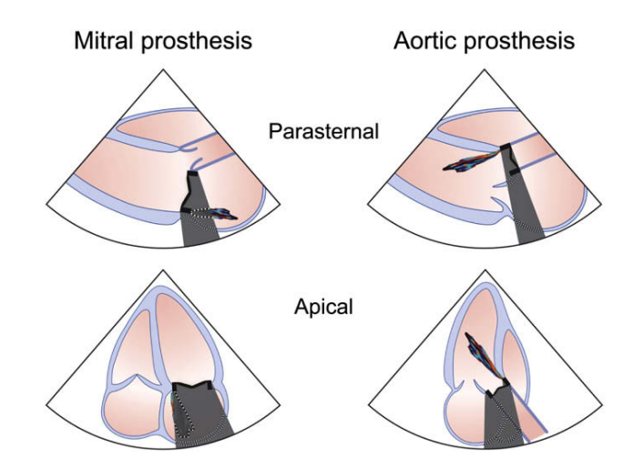
Because of shielding and reverberations of the prosthesis, detection of regurgitation with TTE is more difficult for valves in the mitral & tricuspid positions
Journal of the American Society of Echocardiography Volume 22 Number 9

Slide 17
When to assess by Echo
American Society of Anesthesiologists : Intraoperative TEE - class II indication
ACC & AHA practice guidelines recommend TEE as a class I indication for patients undergoing valve replacement
Prosthetic valve (intraop TEE) assessment
(1) After native valve replacement
(2) Prior to redo valve surgery in dysfunctional prosthetic valve
(3) Unrelated cardiac surgery as a part of comprehensive TEE
Postoperatively, any regurgitation that is graded moderate or severe should be surgically corrected immediately
Notes:
in patients undergoing valve surgery

Slide 18
TTE after valve implantation
Before hospital discharge
at the first visit (6 weeks - 3 months after surgery)
Follow-up Echo
BPVs : annually, from 10 years after implantation
Mechanical valve prostheses : Not needed routinely
After PVL closure : yearly
Notes:
because the incidence of clinically important structural valve deterioration increases markedly more than 10 years after surgery.
At the first visit (2 to 6 weeks after, when the chest wound has healed, ventricular function improved, anaemia - hyperdynamic state has improved

Slide 19
Localisation
Notes:
LAO fluoroscopic view - bileaflet tilting disk mitral PV. 12 o’clock position of the mitral prosthesis is identified by AV. 9 o’clock position of the mitral prosthesis corresponds to the LA appendage. (B) A 3D TEE view of a prosthetic MV viewed in terms of the surgeon view

Slide 20
A comprehensive review of the diagnosis and management of mitral paravalvular leakage Mustafa Ozan Gürsoy. Anatol J cardiol 2020

Slide 21
Ruiz CE, Hahn RT, Berrebi A, Borer JS, Cutlip DE, Fontana G, Gerosa G, Ibrahim R, Jelnin V, Jilaihawi H, Jolicoeur EM. Clinical trial principles and endpoint definitions for paravalvular leaks in surgical prosthesis. European heart journal. 2018 Apr 14;39(15):1224-45.
Notes:
diagnostic work-up for patients with surgical prosthetic PVL

Slide 22
Prosthetic Aortic Valve Regurgitation
PSAX : localize & define the extent of defect
PLAX : jet width and the ratio of jet width to LVOT width
TEE - valvular vs paravalvular / mechanism of regurgitation / associated complications
TEE - limited in the mid esophageal level because of acoustic shadowing anteriorly
Aortic + mitral prosthesis : acoustic shadowing. Obscure LVOT - ideal to evaluate the prosthesis from transgastric positions
Notes:
PSAX : Acoustic shadowing may obscure jets in the region of the noncoronary sinus.
Care should be taken to image the entire circumference of the sewing ring by obtaining multiple imaging planes at and below the level of the sewing ring

Slide 23
Notes:
TEE: Perivalvular significant AR demonstrating (arrows) the extent of dehiscence and regurgitation in cross-section and diastolic flow reversal in the descending aorta. 1. Flow convergence in the aortic root, VC, an eccentric jet directed anteriorly in the LVO toward the septum (left upper panel)
Because of jet eccentricity, measurement of jet width to LVO diameter is not advised here

Slide 24
Ruiz CE, Hahn RT, Berrebi A, Borer JS, Cutlip DE, Fontana G, Gerosa G, Ibrahim R, Jelnin V, Jilaihawi H, Jolicoeur EM. Clinical trial principles and endpoint definitions for paravalvular leaks in surgical prosthesis. European heart journal. 2018 Apr 14;39(15):1224-45.

Slide 25
The proportion of the circumference of the sewing ring occupied by the neck of the jet
<10% = mild; 10–20% = moderate; ≥20% = severe
> 25-30% involvement : indication for surgical repair
Semi-quantitative method, not been validated for multiple jets

Slide 26
PV mitral regurgitation
TTE : LV function, LA often obscured
TEE : excellent visualization of LA & MR, limited visualization of LV
PLAX view :
Mitral valve prosthesis may obscure portions of the LA & posterior wall
difficult to detect small degrees of MR & precise origin or VC
PSAX view :
Leaflet excursion, sewing ring & circumferential extent
Mechanical valves - limited by acoustic shadowing of the posterior aspect
Notes:
a major consideration in the evaluation of MR : effect of acoustic shadowing by the prosthesis. worse with mechanical valves than with BPVs.
Comprehensive assessment of prosthetic mitral valve function often requires both TTE + TEE imaging when valve dysfunction is suspected

Slide 27
Apical view -
leaflet excursion - visualised
Thrombus, pannus, Vegetations - often masked
Paravalvular leaks may be seen (origin is outside the sewing ring)

Slide 28
Notes:
severe paravalvular MR. TTE : Acoustic shadowing of the LA (arrows) significantly mask the regurgitant jet by color Doppler (single white arrow)
TEE : extent of valvular dehiscence (green arrow), severity of regurgitation by color Doppler

Slide 29
Ruiz CE, Hahn RT, Berrebi A, Borer JS, Cutlip DE, Fontana G, Gerosa G, Ibrahim R, Jelnin V, Jilaihawi H, Jolicoeur EM. Clinical trial principles and endpoint definitions for paravalvular leaks in surgical prosthesis. European heart journal. 2018 Apr 14;39(15):1224-45.

Slide 30
Notes:
TTE suggestive of significant prosthetic MR in mechanical valves with normal pressure half-time

Slide 31
PV Pulmonary regurgitation
Located anteriorly and superiorly : difficult to fully visualize by TTE / TEE
Notes:
RVOT view - modified from the PSAX at the aortic level, subcostal view in young patients

Slide 32
PV Tricuspid regurgitation
TEE considered if suspected prosthetic TR

Slide 33
3D ECHO Precise location, number, shape, size, severity, Device placement, complication assessment, residual leak assessment
Notes:
Real-time 3D TEE showing the crescent shape of the mitral leak at 9-11 o’clock.

Slide 34
TAVI - PVL
Most frequent periprocedural complications of TAVI
Multiple sites
Calcium at the commissures is a risk factor
Newer-generation valves show significantly reduced PVL (0-2%)

Slide 35
Notes:
TTE : anterior PVL
D-E : TEE : posterior PVL on mid-esophageal 120 degrees, short-axis views (E);
F : Transgastric view (F) : 2 PVL jets , one is anterior and the other is posterior.

Slide 36
Notes:
Intra-procedural assessment of PVL following TAVR: All panels are from the same patient.
(A) Mid-esophageal TEE long-axis view - paravalvular AR (white arrows). (B) Deep transgastric view showing the paravalvular jet seen in panel A (C) Mid-esophageal short-axis view showing a paravalvular jet (red arrow), and a pinhole jet (arrow head). It is important to scan the valve and image at the lower end of the valve stent to ensure that the measured jet reaches the LV. The circumferential extent of the larger jet here is 14%. (D) 3D planimetry of PVL - 0.22 cm². 3D echocardiography makes it possible to precisely identify the VC (E) Mid-esophageal TEE - desc. thoracic aorta - non holodiastolic flow reversal by PWD.
(F) Simultaneous LV and aortic (Ao) pressure tracings : the basis for the AR index. In this case, the AR index is 28%. Indices of <25% have been reported to have increased 1-year mortality. However, this value is very dependent on aortic and ventricular compliances as well as the severity of paravalvular regurgitation. Red arrow denotes diastolic BP – LVEDP. (G) Diastolic still frame from post-implantation aortogram showing 2+ paravalvular AR (outlined area).

Slide 37
Invasive hemodynamic indexes for assessing severity of AR immediately After TAVR

Slide 38
CMR
Quantification of prosthetic RV and RF
Direct method : contrast CMR to quantify antegrade and retrograde blood flow at a given location
Indirect quantification : Comparison of RV & LV stroke volumes
Combination of both : the difference between the LV stroke volume and aortic flow to quantify MR
CMR may be useful as a complementary tool.

Slide 39
Notes:
IN SUMMARY....

Slide 40
MANAGEMENT Surgical v/s Transcatheter

Slide 41
Surgical correction
1. Valve replacement
2. PVL repair - direct suturing / patch closure / incoorporation of full
thickness autologous tissue
Failure rate :12 - 35 %
Operative mortality : 14 %, 35 % if emergency
Recurrence at the same location - 13 % & 35 % after 1st & 2nd redo surgery respectively
2017 ACC / AHA : Class Ic recommendation

Slide 42
Transcatheter v/s surgical 1
Notes:
JACC 2024
**. Operative mortality for surgical replacement of a dysfunctional mechanical or bioprosthetic valve is 5–14%

Slide 44
2

Slide 45
2017 ACC/ AHA indication for percutaneous PVL closure (Class IIa)
1. symptomatic HF NYHA III, IV
2. persistent hemolytic anemia
3. suitable anatomy
PVL closure of less severe defect is controversial
Contraindications
1. active IE
2. regurgitation of > 1/3rd of the valve ring
3. intra cardiac thrombus / vegetation
4. Unstable / rocking prosthesis

Slide 46
Transcatheter closure of PVL
Favourable | Unfavourable
> 5 mm from the sewing ring | <2 mm from the sewing ring
Small PVL | Large PVL
Single defect | Multiple
straight/short tunnel | slope tunnel
 | Rocking valve
 | Calcified paravalvular tissue
 | IE

Slide 47
Approach
Mitral PVL
1. Antegrade transseptal
2. Retrograde transpical
3. Retrograde aortic
Notes:
Arteriovenous rail → when difficulty in crossing the lesion, can place multiple occluders quickly within a matter of minutes
TS approach: allow more direct access to the leak origin.

Slide 48
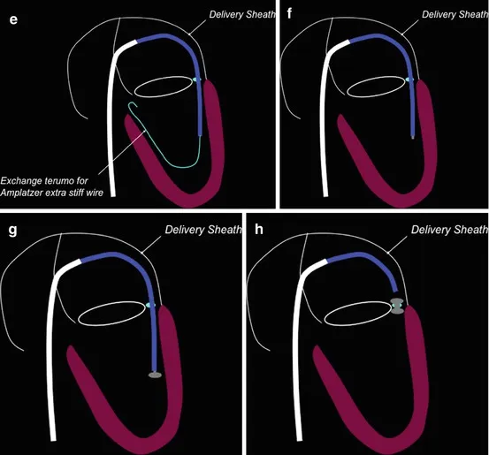
Antegrade transseptal approach
thoracickey.com.percutaneous-paravalvular-leak-closure
Notes:
Transseptal access using a Mullins sheath --> PVL crossed with a glidewire & support catheter (Berenstein catheter / JR 4 DC) --> wire is passed into the descending aorta, snared & exteriorized --> delivery system is introduced & device placed

Slide 49
Retrograde aortic
Retrograde Transapical
Notes:
2. when the PVL cannot be crossed in an antegrade fashion. eg : there are mitral and aortic prostheses.
Trans apical --> Leak is crossed --> the wire is snared in the LA & exteriorized through the Mullins sheath. The delivery sheath can be delivered either antegrade via the transseptal approach or via the transapical approach --> Device placed --> The trans-apical access site is closed

Slide 50
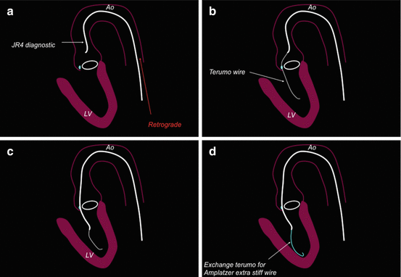
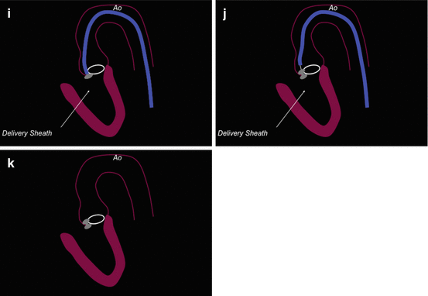
Aortic PVL
Retrograde aortic approach : m/c

Slide 51
Percutaneous Paravalvular Leak Closure – Imaging, Techniques and Outcomes – Amar Krishnaswamy et al. Circulation Journal Vol.77, January 2013
Notes:
Femoral approach to aortic PVL closure. (A) Stiff angled glide wire (SAG) is advanced across the PVL via an AL-1 GC (B) The Glide catheter is advanced to
LV to exchange the SAG for a stiffer Lunderquist wire. (C) Delivery sheath is advanced to the LV and (D) Amplatzer Vascular Plug II deployed

Slide 52
Transseptal approach
IAS puncture , mullins sheath introduced in to LA - LV --> Exchange length hydrophilic guidewire is passed across PVL --> descending aorta --> snared & exteriorized through the femoral artery sheath.
Continuous rail is created : RFV - Across IAS - LV - Aortic PVL - FA
Advance delivery sheath --> retrograde / antegrade
Notes:
Not able to cross retrogradely.
Entrapping the AML --> may lacerate the mitral valve resulting in acutely severe, fatal MR

Slide 53
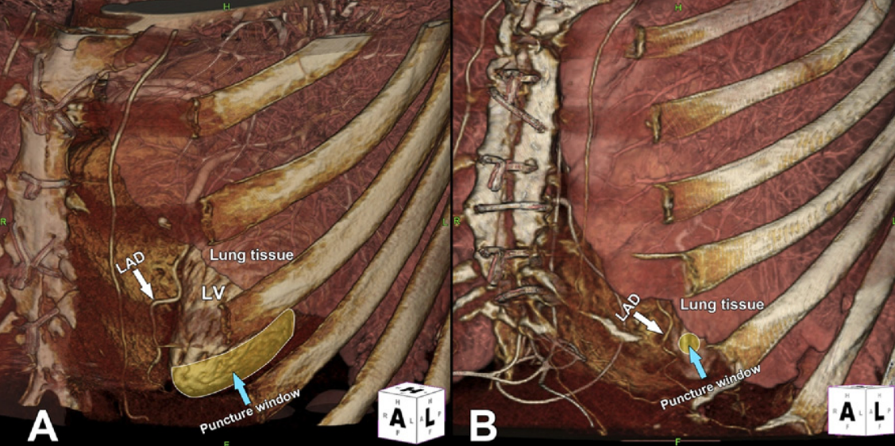
Transapical approach :
Clinical Experience With Percutaneous Left Ventricular Transapical Access for Interventions in Structural Heart Defects. Vladimir Jelnin et al. JACC 2011
Notes:
In the presence of prosthetic mechanical mitral and aortic valve, or when the aortic PVL cannot be crossed retrograde or antegrade. Apical puncture is guided by 3D CTA.
Angiography confirms appropriate access in the LV apex. Top right, The defect is crossed in a retrograde manner. Bottom left, A 10-mm Amplatzer Vascular Plug II (AVP II) device is deployed. Bottom right, A 6-mm AVP II device is deployed in the transapical access site for closure

Slide 54
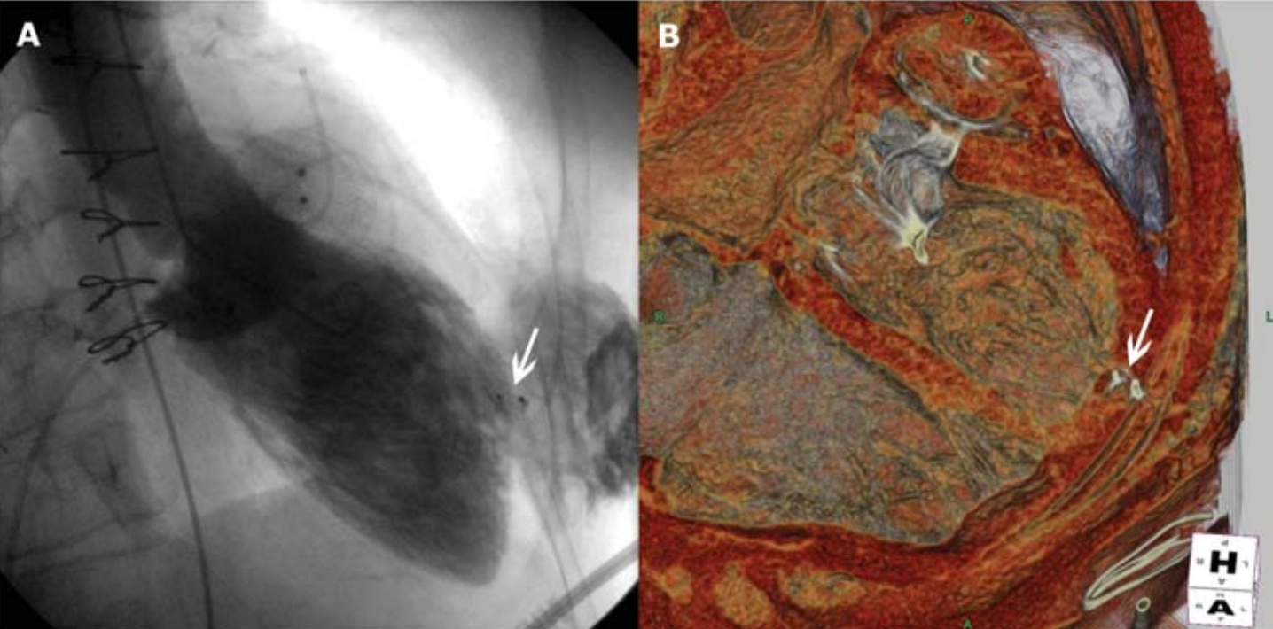
Closing the tansapical puncture :
1. 6 mm Amplatzer PDA device
2. coils
3. Surgiflo (Ethicon 360)
4. Balloon occlusion with the sheath withdrawn, followed by
removal of the balloon when the activated clotting time has
normalized
Notes:
Arrow pointing to the Amplatzer PDA closure device used to close transapical access site (A) LV angiogram (B) 3D-CTA post-processed image

Slide 55
Simultaneous deployment technique (Double wire)
Deployment of multiple devices
20F venous sheath
2 Guide Wires are inserted through 6F GC
and advanced in to LV
2 separate delivery systems are introduced
Devices (eg : 8- to 12-mm AVP II devices) are
advanced & deployed simultaneously
Percutaneous Treatment of Aortic and Mitral Valve Paravalvular Regurgitation. August 2013
Current Cardiology Reports 15(8):388
Notes:
Larger defects and crescend shaped defects

Slide 56
Sequential deployment : Anchor wire technique
Defect crossed with hydrophilic guidewire &
multipurpose catheter
Stiff wire is placed in the LV
Delivery system introduced & device is delivered
without losing access to LV
Device deployed & delivery catheter is removed
It is then reloaded only onto the guide wire - leaving
the device on its delivery cable outside the delivery
catheter
Notes:
If the defect is large but not too large enough for simultaneous device deployment. used to maintain access to the left ventricle during sequential
closure device deployment. Can deploy 3 or more devices as well

Slide 57
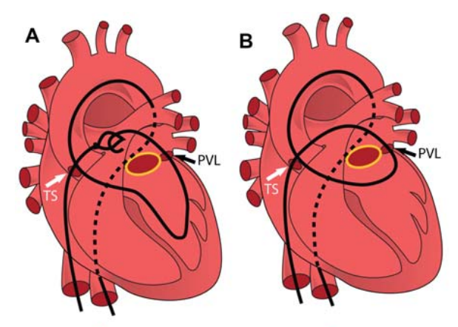
Sequential deployment technique : AV rail
Notes:
Complete control over wire tension & catheter delivery
(A) Transseptal Mullins sheath (black arrowhead) in LA, & retrograde through the prosthetic AV, crossing of the mPVL with the wire coiled in
the LA (black arrow). (B) Snared retrograde wire from the LA into the Mullins sheath being exteriorized out to the femoral vein creating the AV wire loop.
(C) Amplatzer delivery catheter (white arrowhead) being advanced over one of the two wires (a second body-wire was advanced through the same system—white arrow). (D) Amplatzer Ductal Occluder device (AD) being deployed across the PVL with the body-wire in place.
**If either catheter does not cross, additional techniques may be required, such as guidewire snaring and creation of an arteriovenous rail to provide more wire support.

Slide 58
Notes:
wire induced AR due to eccessive tension - evidenced by drop in diastolic Aortic pressure

Slide 59
2D & 3D ECHO imaging throughout the procedure is required
1) Catheter & device positioning
2) Full deployment of the device
3) Interference of the device with PV function
4) Stable device deployment
5) Residual regurgitation
6) Safe removal of catheters & imaging of transseptal shunt

Slide 60
Device selection
Notes:
AVP II - Circular defects. AVP III - slit like / cresentic defects

Slide 61
Outcome analysis
eurointervention journal 2020
Paravalvular leak severity
Symptoms
Notes:
136 patients underwent PVL TC - in 21 centres in nine countries (December 2014–February 2018). Safety data were collected from 136 patients. Baseline and 6 month follow-up data from 106 patients (69 mitral and 37 aortic) were analysed.

Slide 62
Device success rate - 88.9%
Procedural success rate - 86.6%
Clinical success rate - 86.5%

Slide 63
Complications
Peri-procedure complications : Cardiac tamponade, device embolization, stroke, prosthetic damage, access site complications (up to 10% cases)
Late device embolization : rare
Recurrence of PVL

Slide 64
Transcatheter PVL Closure With Covered Stent Tract and Vascular Plug: Tootsie Roll Technique
Notes:
37 patients underwent PVL closure (10 for aortic PVL and 27 for mitral PVL) during the study period. Among them, 8 patients underwent the novel single Tootsie Roll technique: 4 for aortic PVL and 4 for mitral PVL. Technically feasible with 100% success rate in aortic & mital THVs

Slide 65
Case study :Severe calcified paravalvular leak: usefulness of intravascular lithotripsy technology - Elisabetta Ricottini et al
Notes:
Transseptal PVL closure: A) PVL approach using a 10 Fr steerable catheter. A 6 Fr JR guide catheter is inserted into the 10 Fr catheter; a coronary wire is used for crossing the leak and positioning a 2.5×12 mm Shockwave balloon (black arrow, B). C) TEE shows the Shockwave balloon (white arrow) and microbubbles generated by waves. D) An Occlutech PLD Occluder 8×4 mm (asterisk) is positioned through a 7 Fr catheter.

Slide 68
Thank you

